Slide 1



Lesson 6: RWD & Bootstrap
<Web />
Front-end
Development
University of Tehran
Lecturer:
Misagh Mohaghegh
ACM
Summer of Code 2024

Slide 2
A Short Review…
CSS Position (static, relative, absolute, fixed, sticky)
Flexbox container (direction, wrap, justify-content, align-items, align-content, gap)
Flex items (align-self, flex-grow, flex-shrink, flex-basis, order)
Variables (--var-name, var() function)
Transform (translate, rotate, scale, skew)
Transition (smooth transitions)

Slide 3
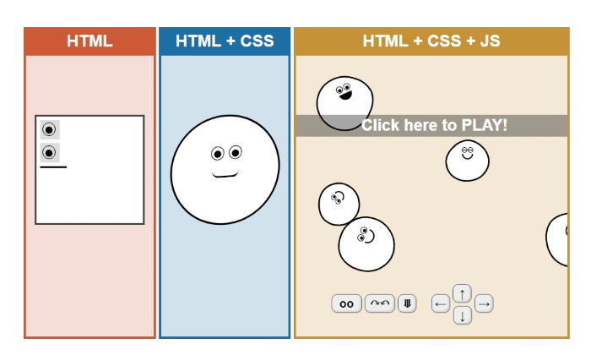
Continue…

Slide 4

Cascading Style Sheets

Slide 5
Responsive Design

Slide 6
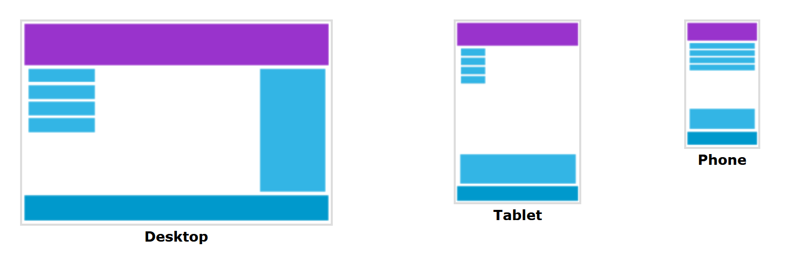
Responsive Web Design (RWD)
Responsive design is when our page adapts to different screen sizes and displays content correctly on all.
This often means that our CSS is used to resize, hide, or move content to make it good on any screen.

Slide 7
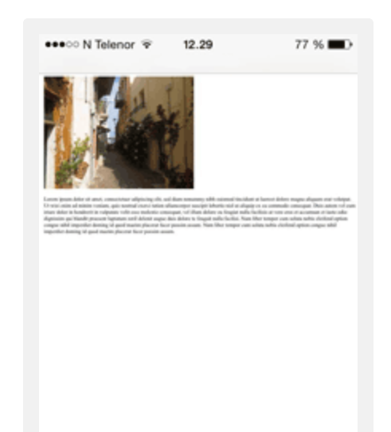
Before Mobile
Before mobile phones, web pages were designed for computer screens.
Computer viewport is too large to fit in a phone, so phone browsers scaled the entire page down.
This means that the same computer page was zoomed out to fit on a phone screen.

Slide 8
Viewport Meta
The following meta tag should always be included for our responsive web page:
<meta name="viewport" content="width=device-width, initial-scale=1.0">
width=device-width: this overrides the mobile browser default which is to render at a high viewport and zoom out to fit on screen.
Initial-scale=1.0: this sets the initial zoom level when the page is first loaded.
Basically, phones lie about their viewport width (for example, the device is 980px wide, but reports 360px)
This is for CSS to understand that the device width is actually small, and use specific styles for it.

Slide 9
Flexible Web Pages
There are many CSS technologies that allow flexible web pages:
Multi column layout (not used much)
Flexbox
Grid
We should also always use the following CSS reset property to avoid images overflowing their container:
img, picture, svg, canvas, video {
display: block;
max-width: 100%;
}

Slide 10
Media Queries
Media queries allow us to check the user's situation and apply CSS for the cases.
One usage is to check the user's screen width and change our CSS according to that.
Media queries are written using the @media at-rule.
An example media query is to check if the user has system dark mode enabled:
@media screen and (prefers-color-scheme: dark) {
body {
color: white;
background-color: black;
}
}

Slide 11
Media Queries
After the @media at-rule, we specify the media type which can be all, screen, or print.
If we don't specify it, it applies for all.
The rule we saw only changed the body colors for the screen, and not in printer view.
This changes for all of them:
@media (prefers-color-scheme: dark) {
body {
color: white;
background-color: black;
}
}

Slide 12
Viewport Media Query
We can use the min-width or max-width properties to change CSS based on the screen width:
@media (max-width: 768px) {
.flex-container {
gap: 2px;
}
}
This media query states that if the screen size is below 768px, the flex gap should be lowered.
min-width is the opposite and only applies if the screen size is above 768px.

Slide 13
Breakpoints
A breakpoint is a max or min-width size in which our website changes CSS.
We can specify many breakpoints with different media queries.
In the previous slide, a breakpoint was defined at 768px.

Slide 14
Desktop First Design
Desktop first design is when the default CSS that we write is written to work on desktop screens.
This means that we are designing for a large screen width first, and using media queries for smaller screens.
Media queries for desktop first design use the max-width property.
h1 {
font-size: 4rem;
}
@media (max-width: 768px) {
h1 {
font-size: 2rem;
}
}
This means that the default font size is for large screens. If the screen size gets small (smaller than 768px),
the font-size should get lowered.

Slide 15
Mobile First Design
Mobile first design is when our default CSS is meant for mobile devices.
So we design for a small width, and use media queries for bigger screens.
Mobile first design queries make use of the min-width property:
h1 {
font-size: 2rem;
}
@media (min-width: 768px) {
h1 {
font-size: 4rem;
}
}
Mobile first design is the new trend and more websites are getting designed this way.

Slide 16
Fluid Container
A fluid (full width) container is a container that expands the whole screen width.
To create a fluid container, we simply set the width of the container element to 100%.
This makes it take the entire parent width.
We should not change this 100% width in our breakpoints.

Slide 17
Fixed Width Container
A boxed (fixed width) container is a container that has a max-width that changes with the screen width.
This means that no matter how large a screen gets, the content will stay in a 900px box for example.
When the screen gets smaller, the box gets smaller in each breakpoint.
.fixed-width-container {
width: 900px;
margin: 0 auto;
}
@media (max-width: 1024px) {
.fixed-width-container {
width: 760px;
}
}

Slide 18

Bootstrap

Slide 19
Bootstrap

Slide 20
Bootstrap
Bootstrap is a CSS framework that provides many premade classes and a grid architecture to make building web pages easier.
Some Bootstrap features require a JS script to be included.
Using Bootstrap, we write less CSS because there are already pre-defined classes that we can use.
But there are still times when we need to write CSS.
The current version of Bootstrap is 5 (v5.3.3 specifically).
Bootstrap 3 and 4 are still supported but not recommended anymore.
Bootstrap 5 removed the jQuery dependency and uses vanilla JS.

Slide 21
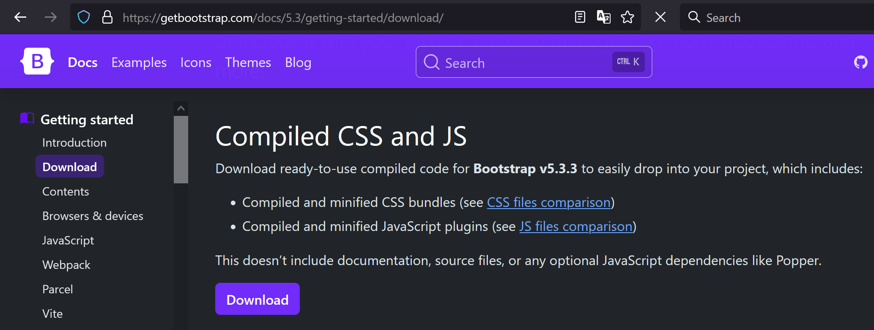
How to Include
To use Bootstrap, first we create a HTML page that correctly defines the <!doctype html> and has the viewport meta tag.
Now we need to link the Bootstrap CSS file.
This can be done using a CDN link or by downloading the Bootstrap files.

Slide 22
How to Include
Online linking:
<link rel="stylesheet" href="https://cdn.jsdelivr.net/npm/bootstrap@5.3.3/dist/css/bootstrap.min.css" crossorigin="anonymous">

Slide 23
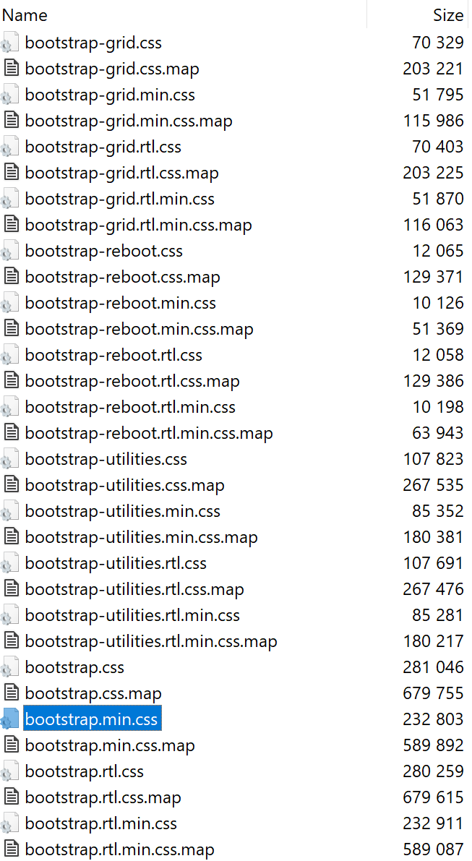
How to Include
Bootstrap is made of different components.
We can clearly see this in the downloaded version:
This allows us the only include what we need from Bootstrap.
The bootstrap.min.css file includes everything and is minified.
Minified files (CSS or JS) have all spacing removed to minimize the size.
This makes them less readable and only useful for production use.
The bootstrap.css file is the actual written code.

Slide 24
How to Include
To use some Bootstrap components that require JavaScript, the following should be included:
<script src="https://cdn.jsdelivr.net/npm/@popperjs/core@2.11.8/dist/umd/popper.min.js" crossorigin="anonymous">
<script src="https://cdn.jsdelivr.net/npm/bootstrap@5.3.3/dist/js/bootstrap.min.js" crossorigin="anonymous">
<script> elements are included at the end of the <body> element.
Popper.js is required for dropdowns, popovers, and tooltips.
We can also use bootstrap.bundle.min.js which includes Popper.

Slide 25
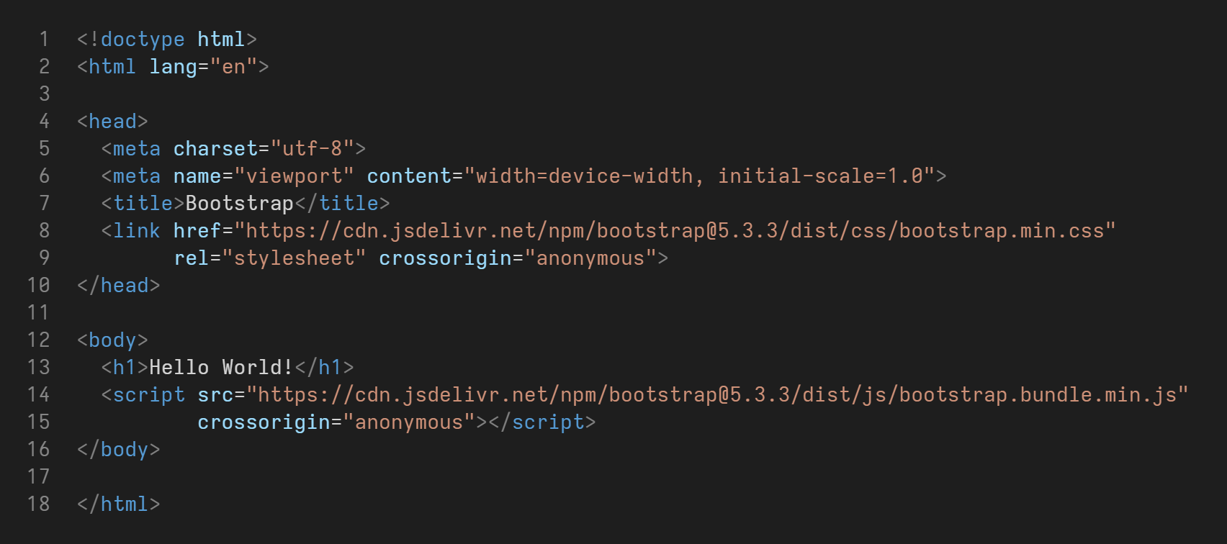
How to Include

Slide 26
Reboot
Reboot is a Bootstrap component that does normalization.
The default box-sizing of all elements is set to border-box.
*, *::before, *::after {
box-sizing: border-box;
}

Slide 27
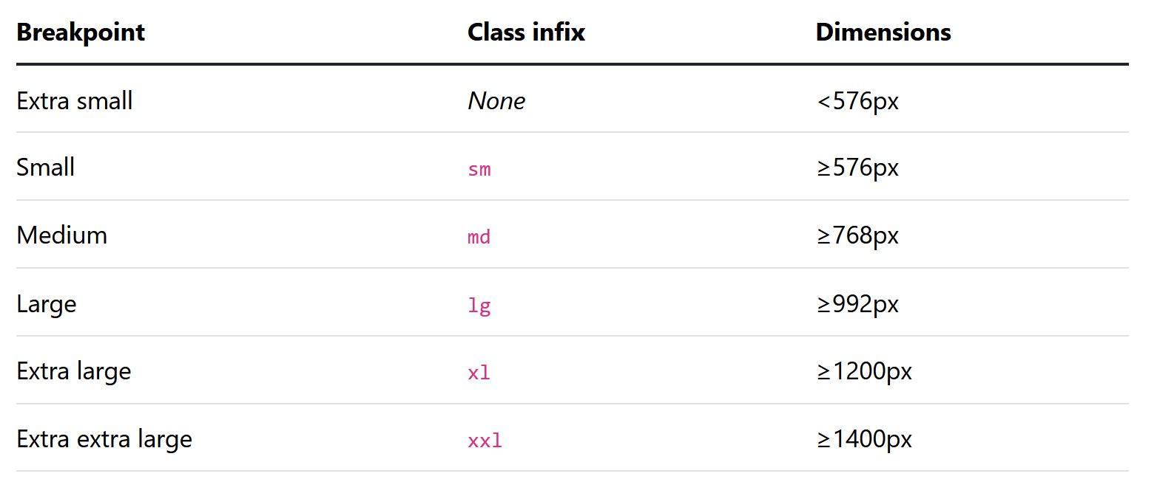
Breakpoints
Bootstrap (since version 3) is a mobile first design framework.
This means that we design for mobile first and apply changes for desktop screens.
The breakpoints are specified using the min-width property.
Bootstrap defines 6 breakpoints:

Slide 28
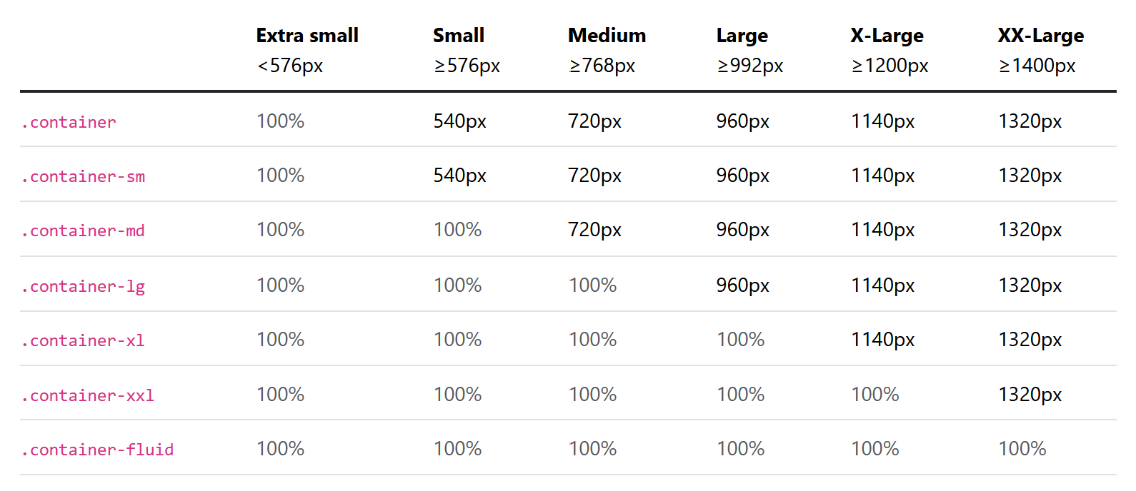
Containers
There are some classes for fluid and fixed width containers.
.container is the complete fixed width container which changes size at each breakpoint.
.container-fluid is a fluid container always taking 100% width.

Slide 29
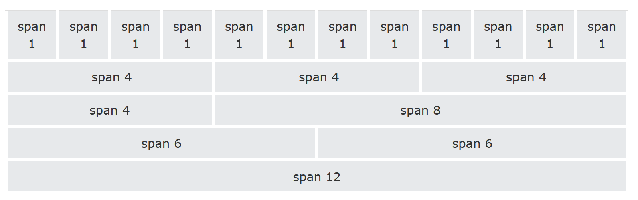
Grid
Bootstrap uses a grid layout to place our items in it. (The grid is actually built using flexbox)
The grid is a 12 column system which supports all 6 breakpoints.
The grid system should be used inside of a container (fixed-width or fluid).

Slide 30
Grid
There is a row and a col class.
The row class is a wrapper for columns which allow applying sizing and gaps for all columns.
The columns are equally distributed based on how many there are.
<div class="container">
<div class="row">
<div class="col">Column</div>
<div class="col">Column</div>
<div class="col">Column</div>
</div>
</div>

Slide 31
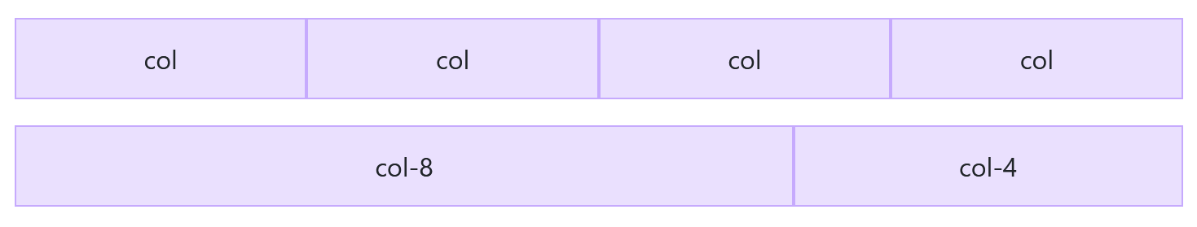
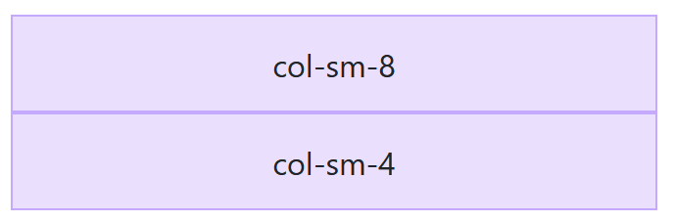
Grid
We can use col-n (such as col-2 or col-6) to make a column bigger.
We can also use col-<breakpoint>-n (such as col-md-2) to change layout responsively.
Here, col-sm-8 means that col-8 is only applied when screen is larger than sm (576px):

Slide 32
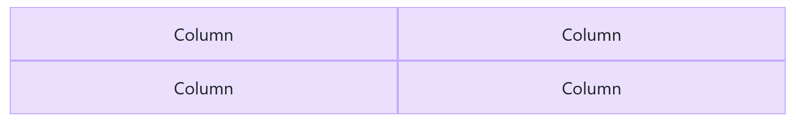
Grid
We can use the row-cols-n class on the row container as opposed to col-n on individual columns:
<div class="container">
<div class="row row-cols-2">
<div class="col">Column</div>
<div class="col">Column</div>
<div class="col">Column</div>
<div class="col">Column</div>
</div>
</div>

Slide 33
Grid Gutters
Gutters or gaps can be applied between columns using the g-n (g-0 to g-5) classes.
We can also only apply gutters on one axis (gx-1 or gy-5).
<div class="container">
<div class="row g-4">
...
</div>
</div>

Slide 34
Padding & Margin
Padding and margin are also applied to elements using the same syntax as gutters.
We have p-n, px-n, py-n, ps-n, pe-n, pt-n, pb-n.
The same applies for margin: m-n, mx-n, my-n, ms-n, me-n, pt-n, pb-n.
<p class="px-2 mt-1">Test</p>
p-n: all 4 sides
px: left and right, py: top and bottom
ps: left (start), pe: right (end)
pt: top, pb: bottom
/* Time to check some code! */

Slide 35
Thank you for your attention.

